Slide 1







English Year 3
Module1
Welcome!

Slide 2







Learning Objectives
By the end of the lesson, pupils will be able to:
Understand specific information and details of short simple texts.
Guess the meaning of unfamiliar words from clues provided by visuals and the topic.
Describe people and objects using suitable words and phrases.

Slide 3




Definition
Of An Adjective
Adjectives are words that describe or modify other words, making your writing and speaking much more specific, and a whole lot more interesting.

Slide 4

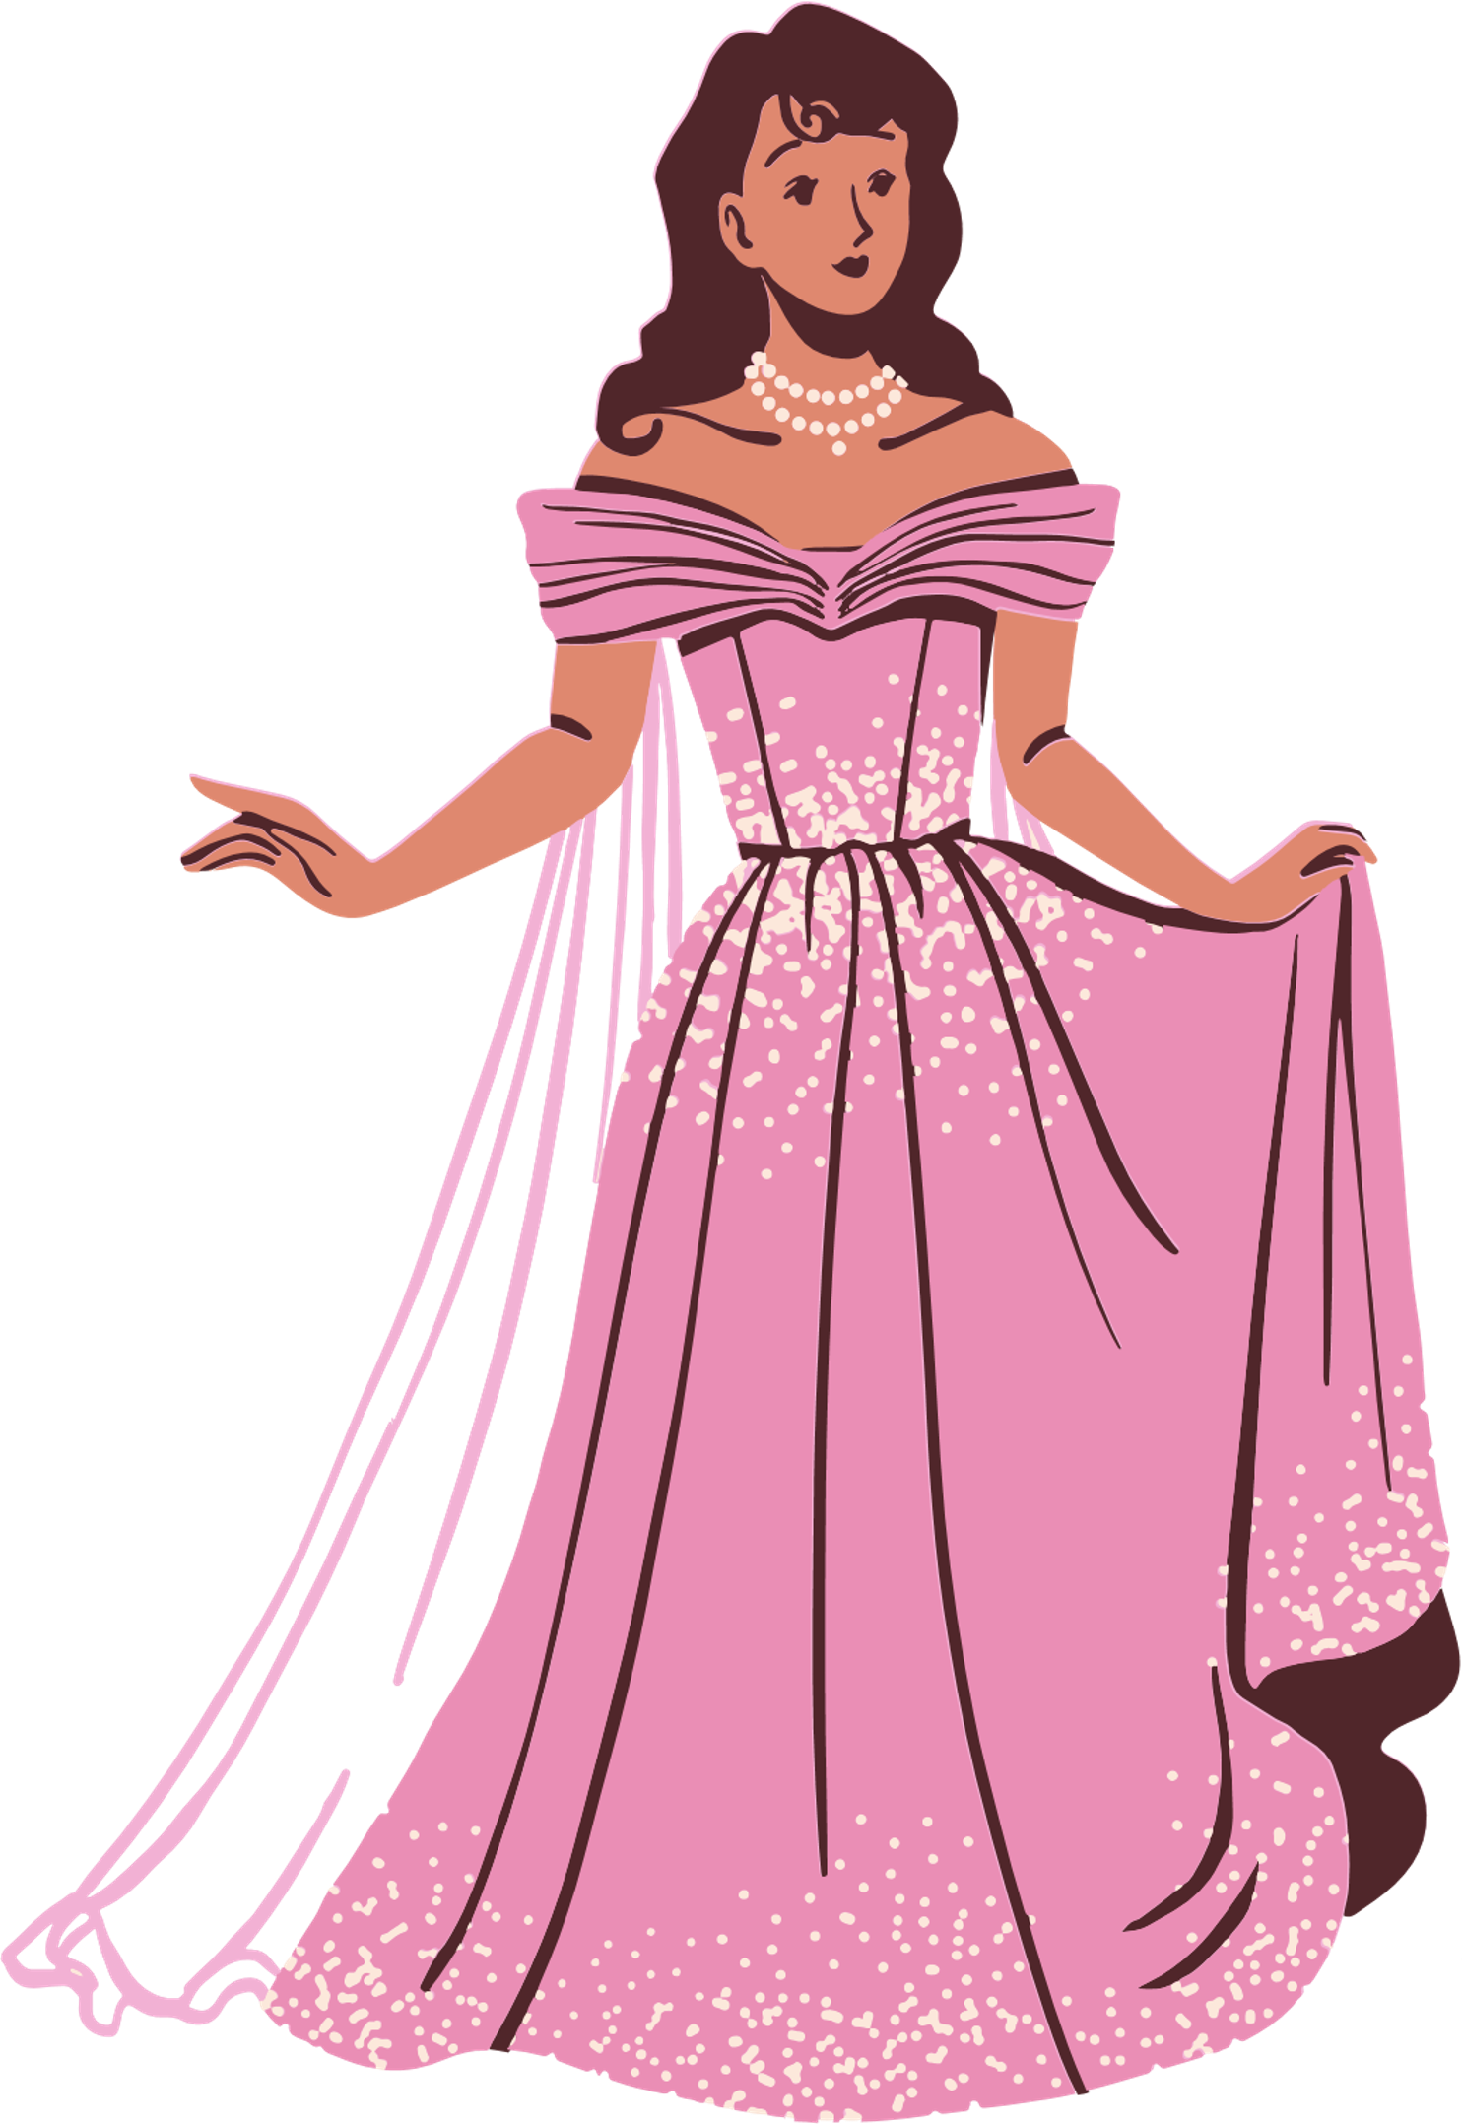
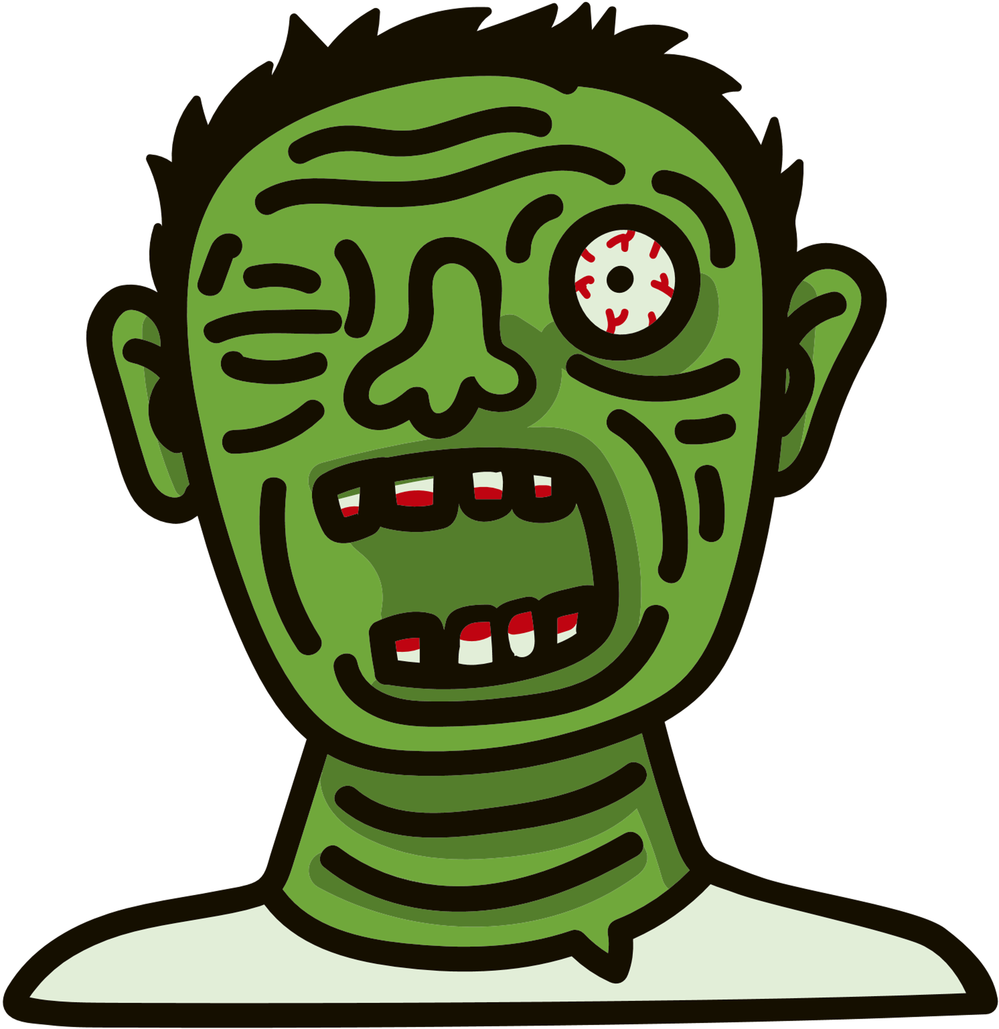
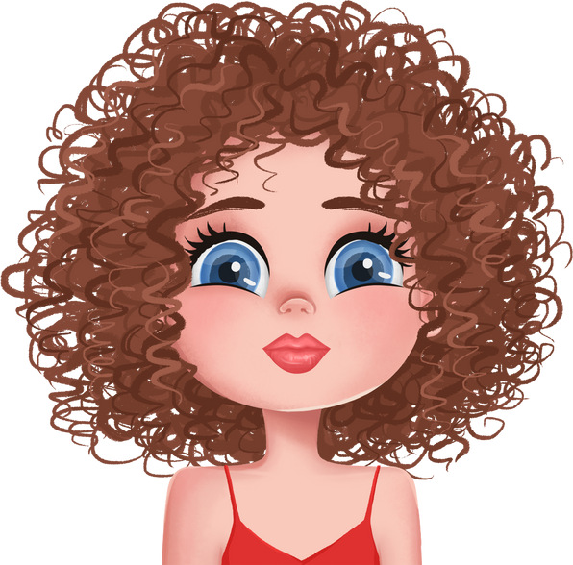
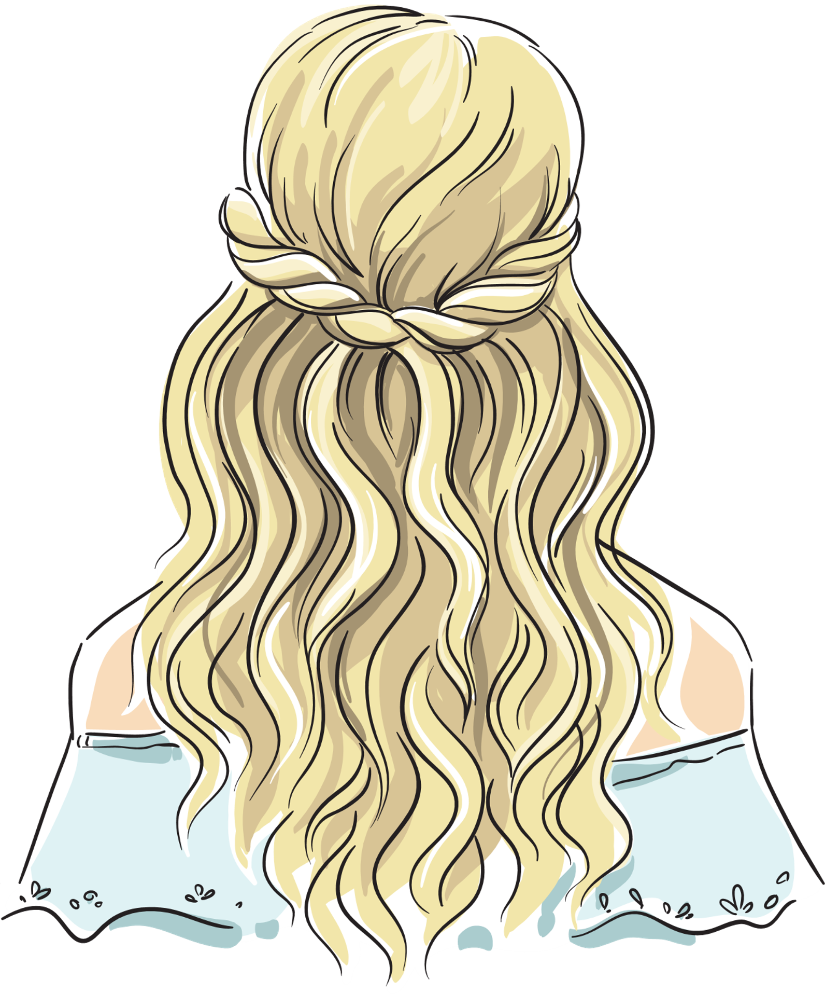
Examples of Adjectives + Pronouns
An ugly monster.
She is a beautiful girl.
She has got curly hair.
She has got blonde hair.

Slide 5
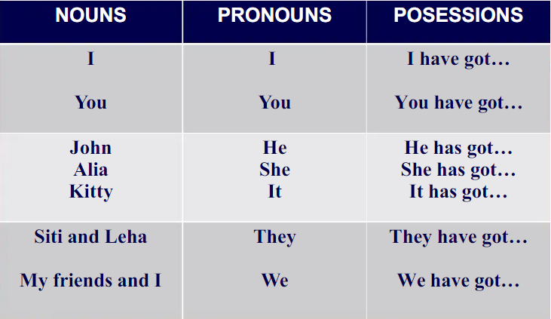

How do we use pronouns & possessions?
PRONOUNS
POSSESSIONS

Slide 6



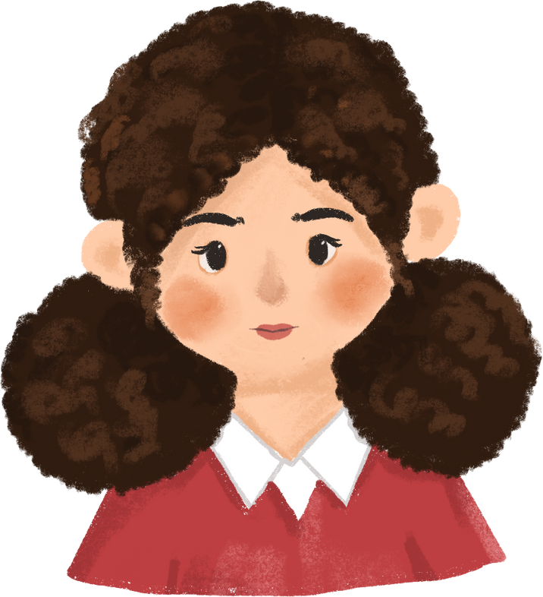
Example:
This is Anne.
She has got curly hair.
She is a beautiful girl.
She has got small lips.

Slide 7

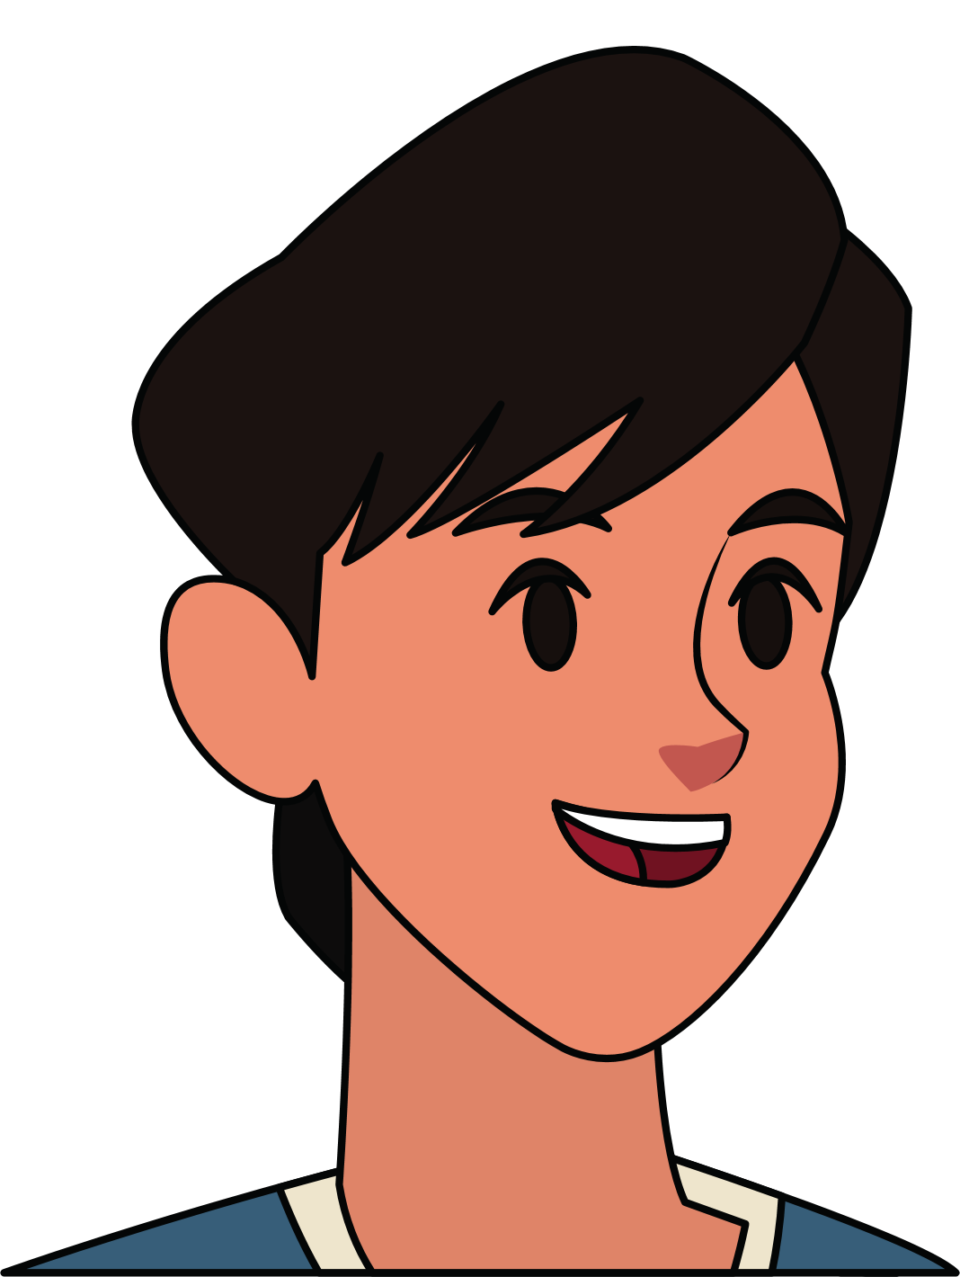


Let's label together!

Slide 8

Let's Look At Numbers
10
20
30
40
50
60
70
80
90
100

Slide 9




Thank you!

